Slide 1
Canadian Rental Market
Group members :
Sweta Joshi
Sakshi Dalal
Rimple Poonia Dabas

Slide 2
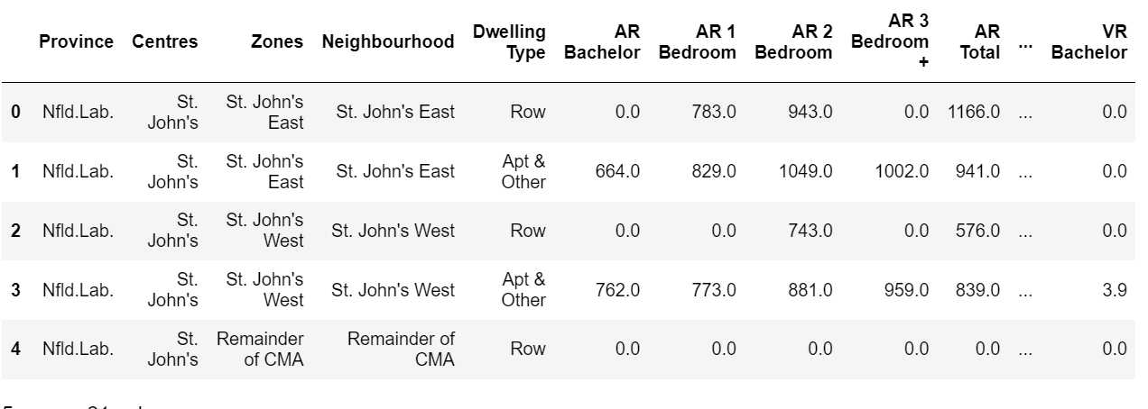

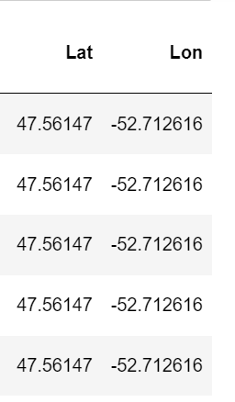

Extract
Transform
Load
App
Data extraction

Slide 3



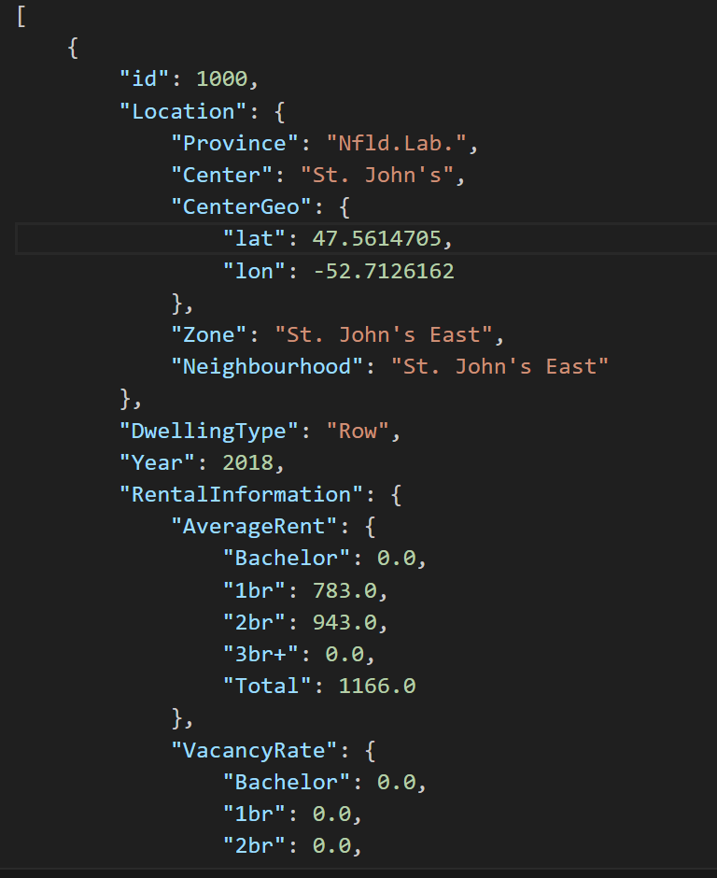
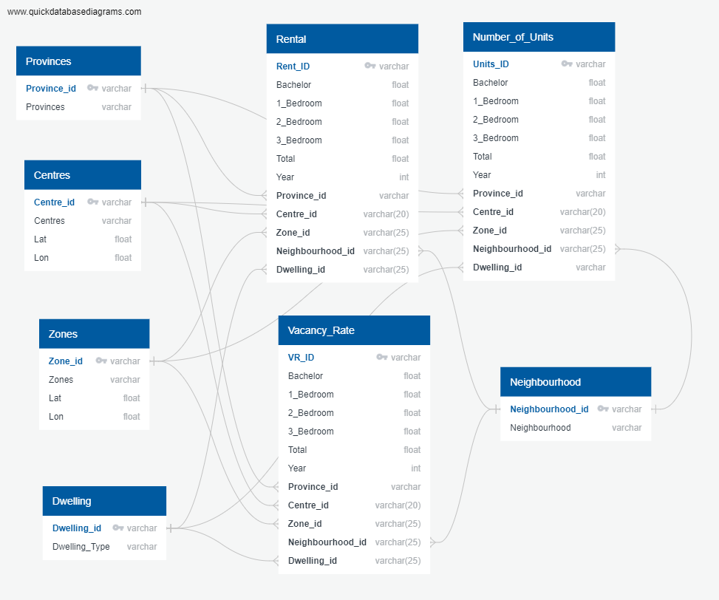
Extract
Transform
Load
App
Data Transformation
Original Data
Json and csv files

Slide 4


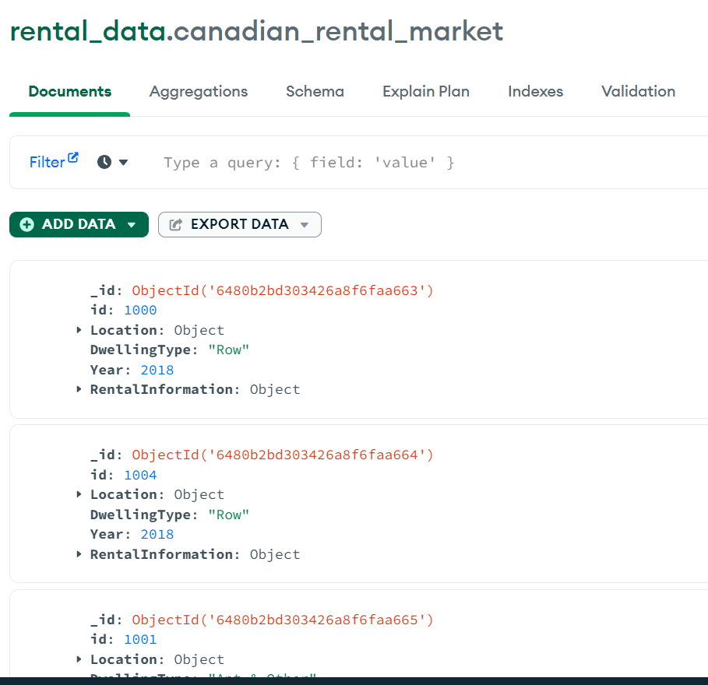
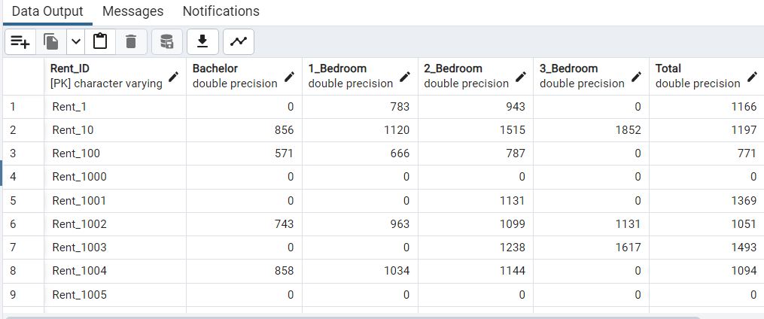
Extract
Transform
Load
App
Data Load
Non-Relational
Relational

Slide 5
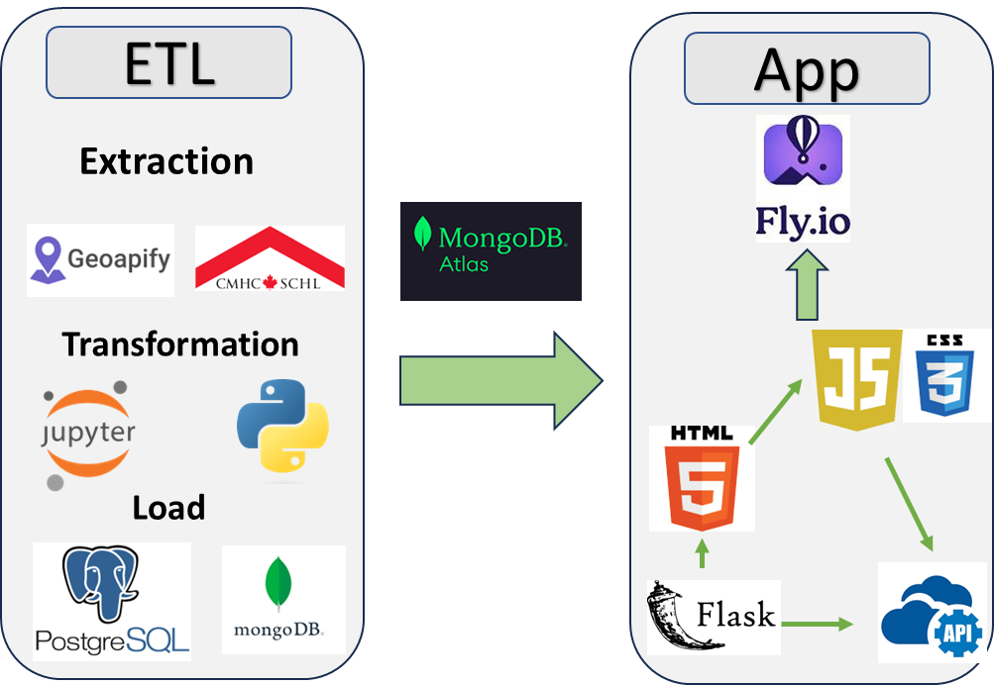
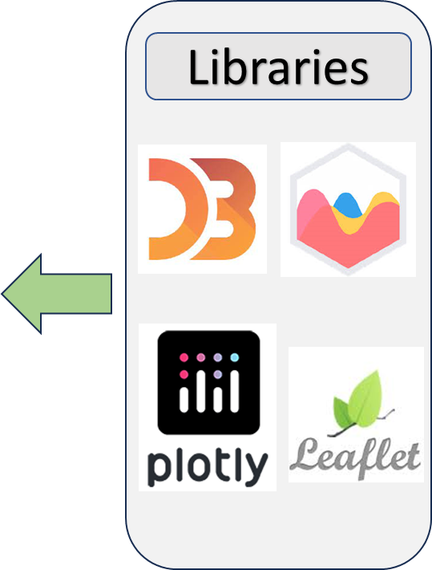
Extract
Transform
Load
App
Overview

Slide 6
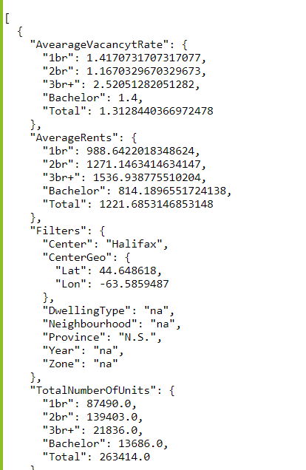
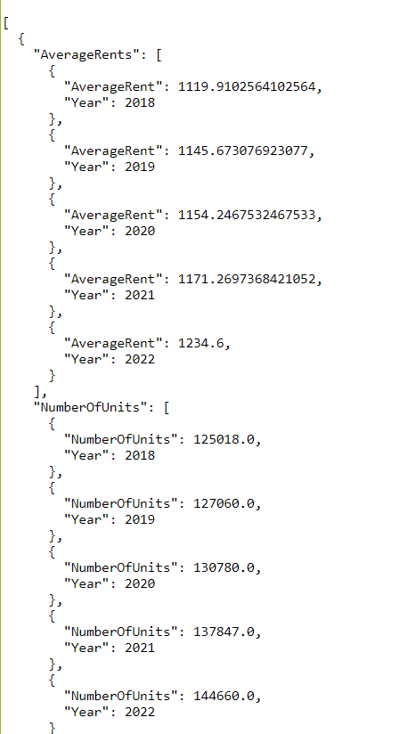
Extract
Transform
Load
App
API Routes
/api/v1.0/province_centers
/api/v1.0/province_trend_by_year
Our APP

Slide 7
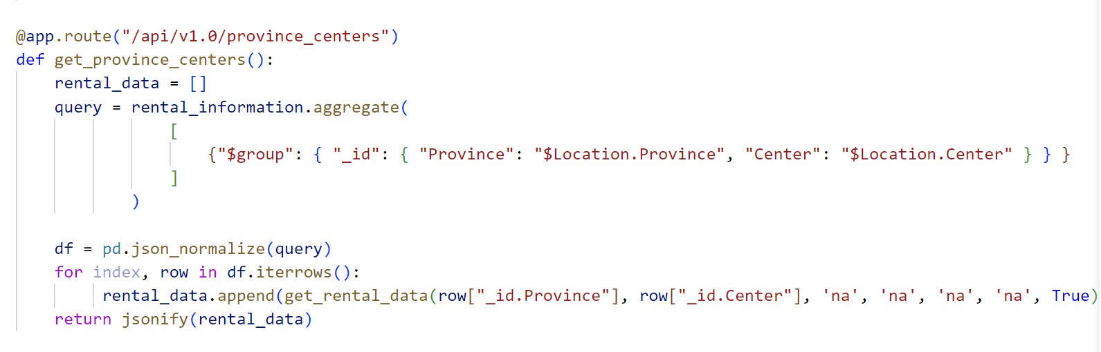
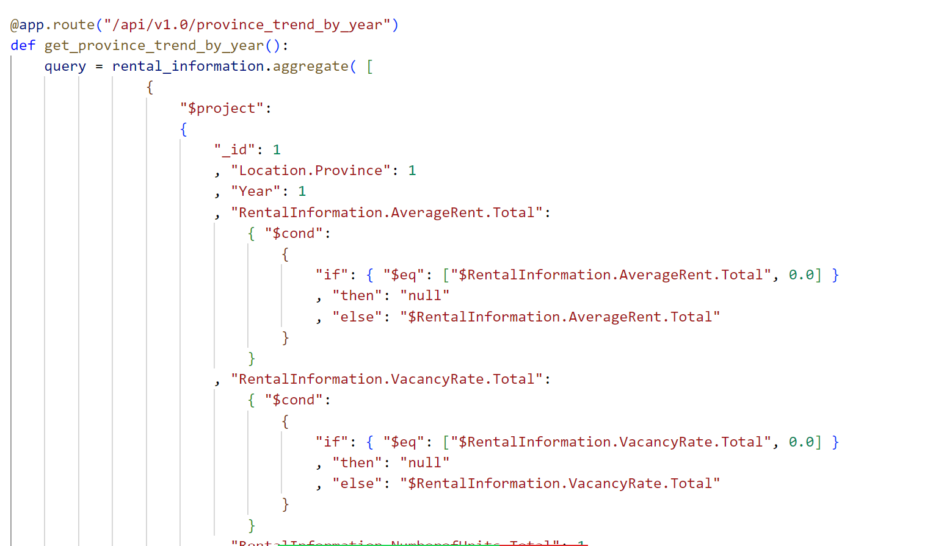
API Routes

Slide 8














ETL
App
Libraries
Extraction
Transformation
Load

Slide 9
